Slide 1

Smart Inventory Optimization System
Backend Code: A Detailed Explanation

Slide 2


Backend Architecture Overview
Django Framework
Robust web framework for rapid development.
MySQL Database
Reliable data storage for inventory and transactions.
ML Module
AI-driven demand forecasting and reorder suggestions.
Django REST Framework
API system for seamless frontend-backend communication.

Slide 3

Backend Root Structure
The smart-stack-backend directory organizes all core components.
manage.py
requirements.txt
Django's command-line utility for server, migrations, and user management.
Lists all Python libraries, ensuring consistent environment setup.
.env
sales.csv
Securely stores environment variables like API keys and database credentials.
Dataset for the ML model, containing historical sales data.

Slide 4

Key Dependencies
Essential Python libraries powering the backend functionality.
Django & Django REST Framework
MySQLclient & CORS Headers
Core for backend logic and API creation.
Database connectivity and secure cross-origin communication.
python-dotenv
numpy, pandas, scikit-learn
Manages environment variables for configuration.
Fundamental libraries for the Machine Learning model.

Slide 5

Backend Project Folder: backend/
This folder houses the main Django project settings and configurations.
settings.py
Defines installed apps: rest_framework, corsheaders, inventory.
Configures middleware for security, sessions, and authentication.
Sets up MySQL database connection using environment variables.
Manages CORS settings and REST Framework integration.
urls.py
Maps root URLs, including /admin/ and /api/ endpoints.

Slide 6





Inventory App: Business Logic Hub
The inventory/ folder contains all core business logic, from database models to AI.
serializers.py
models.py
Converts model objects to JSON for API responses.
Defines MySQL database tables: Product, Store, Stock, Transaction.
views.py
Handles API requests, including reorder suggestions from the ML model.
ml_service.py
The AI module for demand forecasting and reorder quantity calculation.
urls.py
Maps API endpoints for products, stores, stock, transactions, and reorder suggestions.

Slide 7
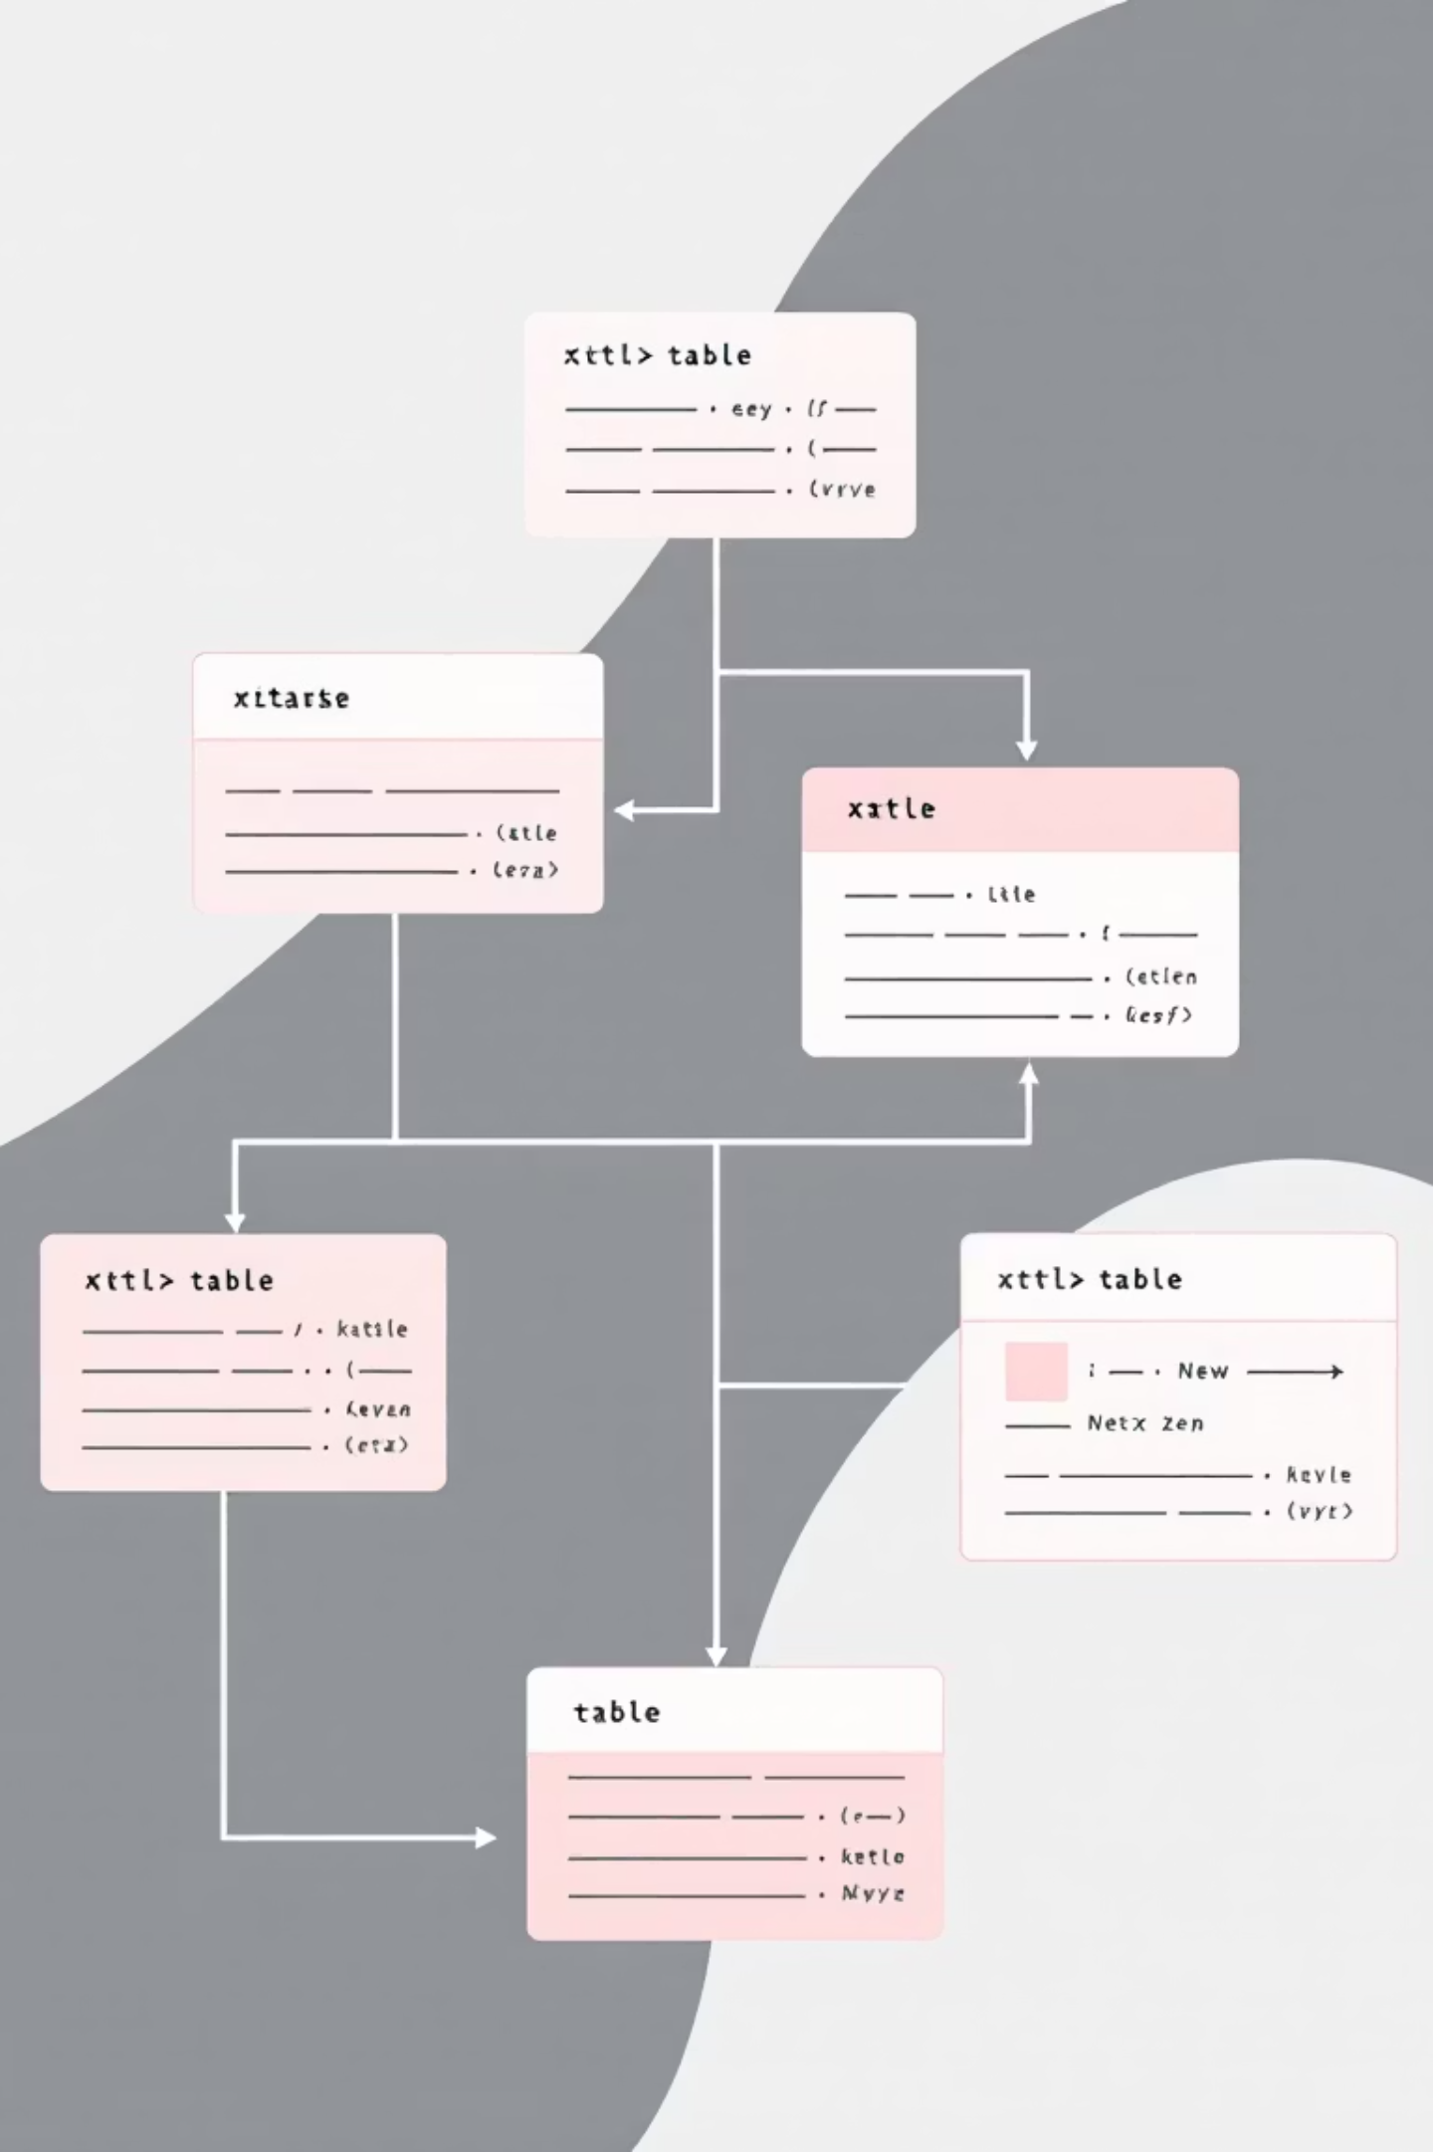
Database Models
Defining the structure of our MySQL database for efficient inventory management.
1
Product
SKU, name, category, reorder point, lead time, safety stock.
2
Store
Name and location of each retail store.
3
Stock
Links store and product to current quantity.
4
Transaction
Records sales or purchases with quantity and timestamp.

Slide 8


AI-Powered Reorder Suggestions
The ml_service.py module drives intelligent inventory decisions.
Load Sales Data
Reads sales.csv to get historical transaction data.
Train ML Model
Uses Linear Regression to predict daily demand for each SKU.
Calculate Reorder Quantity
predicted_demand + safety_stock - current_stock
Return JSON Results
Provides actionable reorder suggestions to the API.

Slide 9
Backend API Endpoints
The gateway for frontend interaction with the backend system.
/products/
1
GET: List all products. POST: Create new product.
/stores/
2
GET: List stores. POST: Create new store.
/stock/
3
GET: List stock levels. POST: Add stock.
/transactions/
4
GET: List transactions. POST: Record new transaction.
/stock/reorder_suggestions/
5
GET: Returns AI-driven reorder suggestions.

Slide 10





Backend Workflow Summary
The brain of the Smart Inventory Optimization System.
Frontend Request
Initiates API call to the backend.
Database Interaction
Backend reads/writes data from MySQL.
ML Forecasting
AI module processes data and forecasts demand.
JSON Response
Backend sends data back to the frontend.
Frontend Display
Visualizes inventory, stock, and AI predictions.

